Slide 1
Floriculture design
By Jessica Johnston

Slide 2
Elements of Floral Design
Line
Form
Space
Design
Texture
Pattern
Fragrance
Size
Color

Slide 3
Line
The visual pathway that directs the eye movement through a compositions
Distance between two points

Slide 4
Line Directions
Vertical lines—stress height and suggest power and strength
Horizontal lines—stress width and are peaceful and calm, provide a sense of stability
Diagonal line—dynamically energetic, causing more eye movement. Use sparingly
Curved line—suggest motion, but are softer, more comforting. Eye moves quickly through design.

Slide 5
What is this picture an example of?

Slide 6
What kind of arrangement is this?

Slide 7
What kind of arrangement is this?

Slide 8
What kind of arrangement is this?

Slide 9
Form
the shape or configuration of an individual component of the composition. The overall, three-dimensional, geometric shape or configuration of a floral composition.

Slide 10
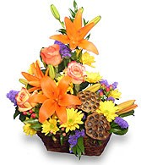
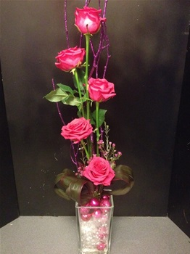

Slide 11
Space
The area in, around, and between the components of the design, defined by the three-dimensional area occupied by the composition.
Positive space- Space filled with materials. It contains shape, form, color, and texture
Negative space- Purposely made. It is important to arrangments appearance. The space where there is no materials. Done with reason.

Slide 13
Texture
The surface quality of a material, as perceived by sight or touch
Smooth, coarse, waxy, rough, delicate, velvety

Slide 14
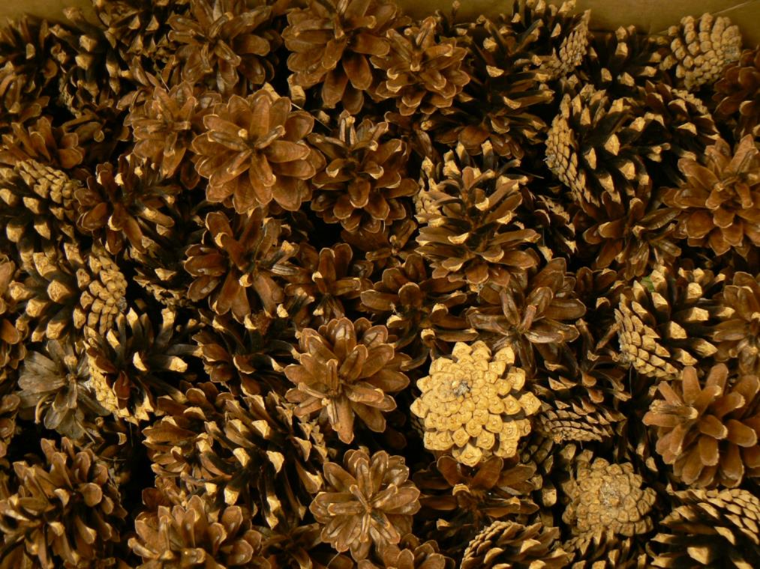
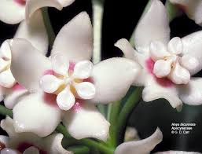

Slide 15
Pattern
A repeated combination of line, form, color, texture, and/or space.
Variegated markings, speckles
Any element used more than once

Slide 16
Fragrance
A sweet or pleasing odor, perceived by the sense of smell.
heightens our awareness
increases sensory enjoyment
triggers memory

Slide 17
Size
The physical dimensions of line, form, or space
Considerations include:
-Cost
-Container to be used
-occasion
-kind of flowers

Slide 18
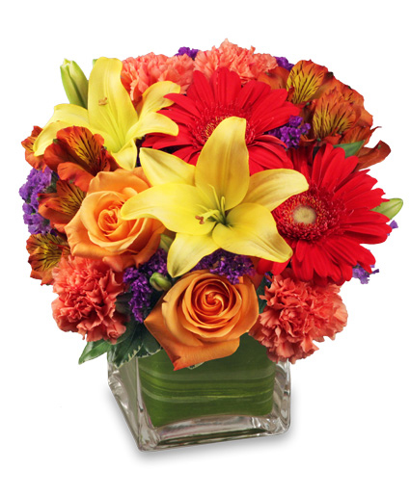
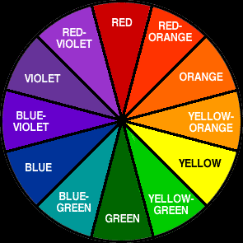
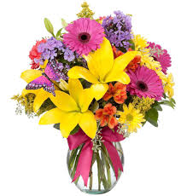
Color
Most Important design element
Must consider the color wheel
Colors must complement and work together
Arrangement needs to be pleasing to the eye
Emotional response

Slide 19
Principles of Floral Design
Guidelines used by florist to create arrangements that reflect and work with the elements of design
Focal Point
Proportion
Scale
Balance
Rhythm
Harmony
Unity

Slide 20
Focal Point
The center of interest in a design
Draws the most attention and directs the viewer’s eye to a specific location within a design.
Located slightly above the rim of the container and extends slightly out in front of the container to give depth.

Slide 21
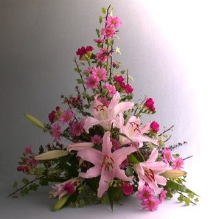
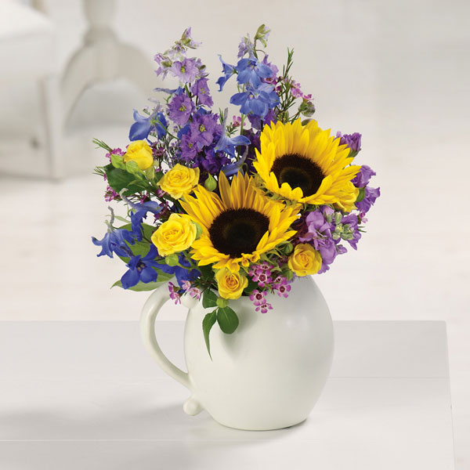
Where is the focal point?

Slide 22
Proportion
Concerns the relationship between the flowers, foliage, and container.
To attain proper proportion:
Smallest flowers should be positioned at the top and edges of the design and as you work towards the focal point gradually increase the flower size.
Plant material should be 1 ½ to 2 times the size of the container

Slide 23
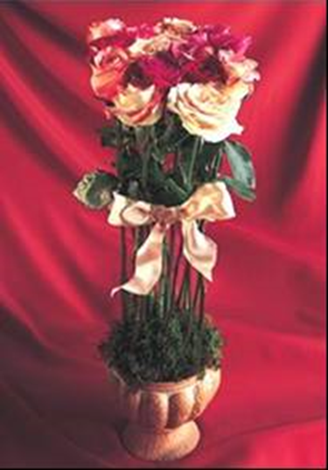
Which arrangement is proportioned?
Left or Right

Slide 24
Scale
The relationship between the completed arrangement and its location or surroundings.
Arrangement should “fit in” where it is placed.
Example: A small arrangement on a large table shows improper scale.

Slide 25
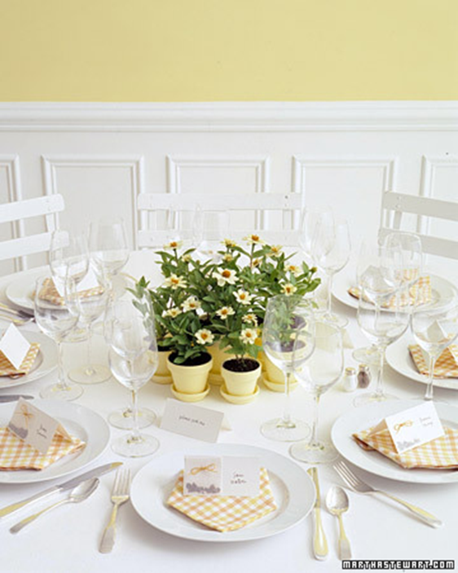
Which arrangement is within Scale?
Left or Right

Slide 26
Balance
Provides an arrangement with the impression of being stable and self-supporting.
Gives “visual weight” to the arrangement and makes it more pleasing to the eye.
Can have symmetrical balance or asymmetrical balance
Overall Balance considerations: Top to Bottom the bulk of the weight should on the lower half of the arrangement near the rim of the container to achieve proper balance.

Slide 27
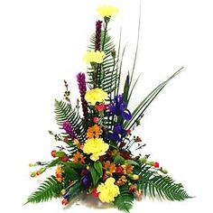
Symmetrical Balance
Formally balanced
Same on each side, appears to be an imaginary vertical line running through the center of the arrangement.
Passive and restful tone

Slide 28
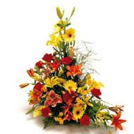
Asymmetrically Balance
Informal and more natural design.
The two sides are completely different, but, visual weight appears equal and balanced.

Slide 29
Rhythm
The apparent flow of lines, textures, and colors that express a feeling of motion rather than confusion.
Rhythm provides a sense of beauty.
Can be achieved through repetition, radiation, and transition.

Slide 30
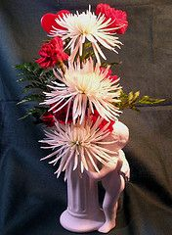
Rhythm through repetition
Accomplished by repeating one or more of the design elements such as color, line, pattern, shape, space, or texture.
Repetition allows the eye to move smoothly from one area to another so the viewer can “see” the entire design.

Slide 31
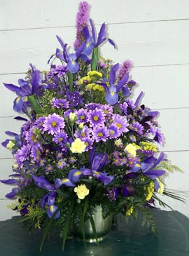
Rhythm through radiation
Placing flowers with their stems originating from the focal point so the flowers appear to radiate from the center of the design.
Creates emphasis at the center of interest and provides visual movement throughout the arrangement.
Gives strong sense of unity and grace to arrangement.

Slide 32
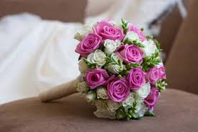
Rhythm through transition
Creates a sense of motion within the design that leads the eye to the center of interest.
Produced by repeating similar shapes in a systematic size progression or spacing identical shapes in a systematic space gradation to achieve transition.

Slide 33
Harmony
For harmony to be achieved, all the parts of the design must be blended in a pleasing relationship.
The flower shapes, colors, textures, and sizes should “fit together” to express a central theme or idea.

Slide 34
Unity
Achieved when all parts of the design combine w/o noticeable separation.
The arrangement should be a complete unit, not just a group of flowers thrown together.

Slide 35
Activity
Make an arrangement out of your classmates

