Slide 1
FCAW illustration
By Nathaniel sexton
Josh ogilvie
Raymond broadway

Slide 2
History
FCAW was first developed in the early 1950s as an alternative to shielded metal arc welding (SMAW). The advantage of FCAW over SMAW is that the use of the stick electrodes used in SMAW is unnecessary. This helped FCAW to overcome many of the restrictions associated with SMAW.

Slide 3
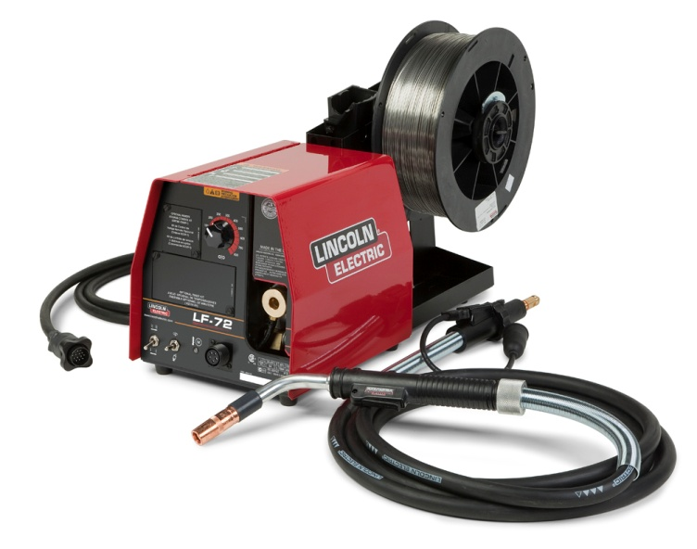
Type
One type of FCAW requires no shielding gas. This is made possible by the flux core in the tubular consumable electrode. However, this core contains more than just flux, it also contains various ingredients that when exposed to the high temperatures of welding generate a shielding gas for protecting the arc just like it would with gas.

Slide 4
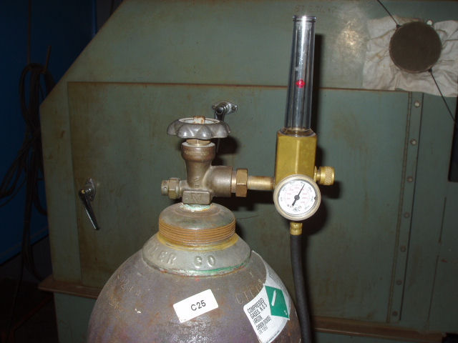
Type (cont)
Another type of FCAW uses a shielding gas that must be supplied by an external supply. This is known informally as "dual shield" welding. This type of FCAW was developed primarily for welding structural steels.

Slide 5
Types of Gas
In the case of dual shielding being used with a flux cored electrode the choices of shielding gasses are limited.
CO2 – Carbon dioxide
Ar – Argon
CO2 / Ar – A mixture of the two
Ar / Ox – A mixture of the two

Slide 6
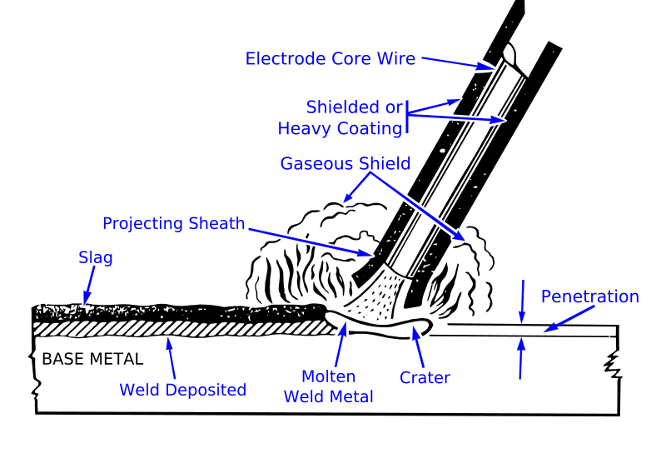
Welding Diagram

Slide 7
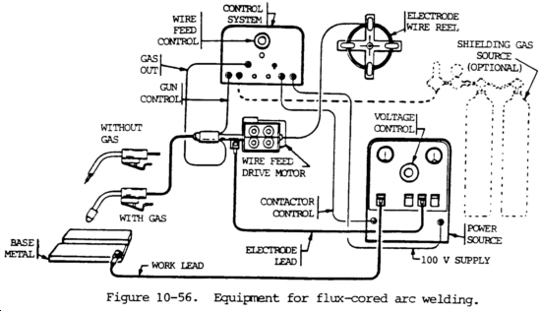
Parts of the Machine

Slide 8
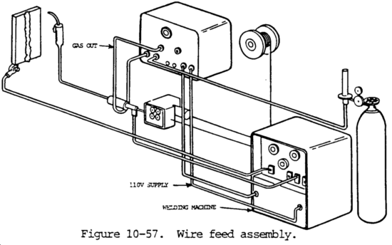
Wire Feed Assembly

Slide 9
Wire Feed Assembly (cont.)
A wire feed motor provides power for driving the electrode through the cable and gun to the work.
There are several different wire feeding systems that could be used, it all depends on the use.
Generally most machines are set up for the constant speed type. (constant voltage power sources)

Slide 10
How to read Wire
E signifies electrode
7 indicates tensile strength (here, 70,000 pounds per square inch.
0 indicates flat and horizontal positions (1 would imply a wire has all-position welding capabilities)
T signifies a tubular (flux-cored) wire
1 indicates the wire's usability and performance capabilities, including its operating parameters
C designates that the product is to be used with 100 percent CO₂,shielding gas only

Slide 11
Wire Feed Size
E71T-1 (FCAW-G): Highest deposition rates out-of-position. E71T-8 (FCAW-S): Highest deposition rates out-of-position without a shielding gas. E70T-4 (FCAW-S): Highest deposition rates in the flat position. E70T-1 (FCAW-G): Highest deposition rates in the flat position with properties. E71T-14 (FCAW-S): Fastest travel speed on galvanized and coated steels. E70T-5 (FCAW-G): Fastest way to weld hard-to-weld steels.

Slide 12
Electrical
Most power sources (the welding machine) operate on 230 or 460 volt input power, but machines that operate on 200 or 575 volt input are also available.
Flux-cored arc welding generally uses higher welding currents than gas metal arc welding, which sometimes requires a larger power source. It is important to use a power source that is capable to handle this.

Slide 13
Welding Positions
The techniques used for this process are very basic and don’t require much skill besides machine setup.
Forehand welding produces a shallow but wide, penetrating weld.
Backhand welding produces a narrow, deep, penetrating weld .
There are the whipping, circles and weave techniques/patterns
The vertical position and overhead can also be used.

Slide 14
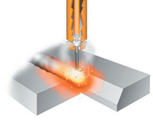
Welding Positions(cont)
When it comes to welding techniques, always remember that it is mainly all about machine set-up.

Slide 15
Process
Flux Cored Arc Welding (FCAW) is quite similar to MIG/MAG welding as far as operation and equipment are concerned. However, the electrode is not solid but consists of a metal sheath surrounding a flux core. The electrode begins life as a flat metal strip, which is formed first into a ‘U’ shape. Flux and alloying materials are deposited into the ‘U’, which is then closed into a tube by a series of forming rolls.

Slide 16
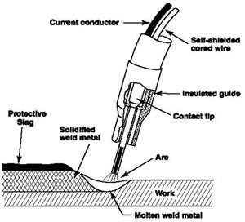
Process (cont)

Slide 17
Pros
Versatility - suitable for a variety of positions and applications
Capable of relatively high deposition rates
Enables “one process” operation for individual projects – simplifies training, supervision and logistics
High production factor compared to SMAW and GTAW since the process uses a continuous electrode.
Low Hydrogen weld deposit with all electrodes

Slide 18
Cons
Incorrect selection of consumables and parameters may lead to lower weld toughness
Potential for lack-of-fusion type defects if welding parameters are incorrect or misalignment occurs
Fume extraction may be required
The gun is difficult to get into tight places.
Not very suitable for precision type work as compared to GTAW

